Slide 1
ACALYPHA INDICA
DR Gokul Krishna k

Slide 2
Scientific Name – Acalypha indica
Family – Euphorbiaceae
Kingdom: Plantae

Slide 3
Common Name: Indian Nettle, Indian acalypha, Indian nettle, three-seeded mercury
Tamil: Poonamayakki, Kuppaimeni

Slide 4
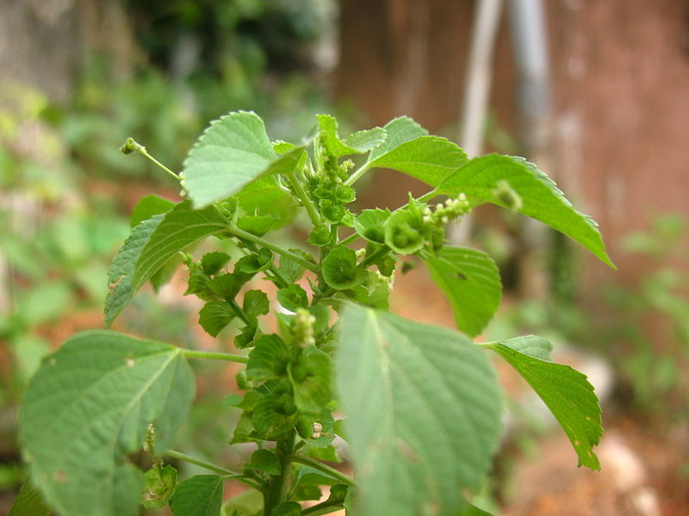

Slide 5
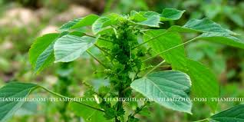

Slide 6
It is a common herb growing up to 75 cm tall with ovate leaves and flowers are green.
Geographic distribution
It grows widely throughout the tropics of the Old World such as India, South East Asia, and Oceania.

Slide 7
Chemical constituents
Acaiyphine and Triacetoneamine
Sphere of action
Alimentary canal and respiratory organs.

Slide 8
RESPIRATORY SYMPTOMS
Violent dry, hard cough followed by bloody expectoration.
Pure blood comes in the morning and dark lumps of clotted blood in the evening.

Slide 9
Cough with constant severe pain in chest.
Cough < night
TIME
Night : cough most violent.
Morning : expectorates pure blood.
Evening : expectorates dark clotted blood

Slide 10
GASTRO INTESTINAL SYMPTOMS
Burning sensation is felt in stomach and intestines.
Spluttering diarrhoea with forcible expulsion of noisy flatus.
Gripping pain in the abdomen
Rectal haemorrhage < evening.

Slide 11
SKIN
Circumscribed furuncle-like swelling
Itching
Jaundice
RELATIONSHIP
Compare: Millifolium, Phosphorus, Acetic acid, kali Nitricum

Slide 12
MEDICINAL USES
as an expectorant to treat asthma and pneumonia
antibacterial and antifungal activities, both against human and plant pathogens
The leaf powder, sometimes mixed with salt, is applied externally to maggot-infested wounds, skin parasites and other skin problems
A leaf decoction is used as a massage cream to treat pain of the joints.

Slide 13
Internal uses:
Digestive system: Purgative, GI irritant
Respiratory system: Expectorant , useful in bronchitis
Urinary system: diuretic
Skin: Skin disease , useful in ulcer

Slide 14
Part used:
Leaves , root
Dosage:
1-2 gm.
Therapeutic Uses:
Leave paste useful in syphilis
Leave paste used in insect bite

Slide 15
THANK YOU……………..

